Slide 1

Optical Character Recognition System
By: Aayushi Gupta, Mila Hristova
Subject Name: AI System Technologies
Subject Code: EAI 6020

Slide 2

Introduction
Cemeteries serve a vital function in the community.
The data was usually kept in paper books or spreadsheets and updated manually.
This method is very time-consuming, inefficient, and cost-ineffective. It is also difficult to update and manage the records.
Moving to a digital cemetery management system is important to accurately prepare and cleanse burial records from scanned paper-based records to a useful digital format, which can subsequently be consumed/migrated to a Cemetery Management System to obtain value.
With the help of a cemetery information management system, one can back-up all the records and control who has access to the data.

Slide 3
Project Description
AIM: To extract data from various scanned paper-based burial records and store it in a digital format for easy access and usage
Language Used: Python programming language
Packages used: OpenCV and Cloud Vision API
Database used: CSV files
Visualization tool used: Power BI

Slide 4
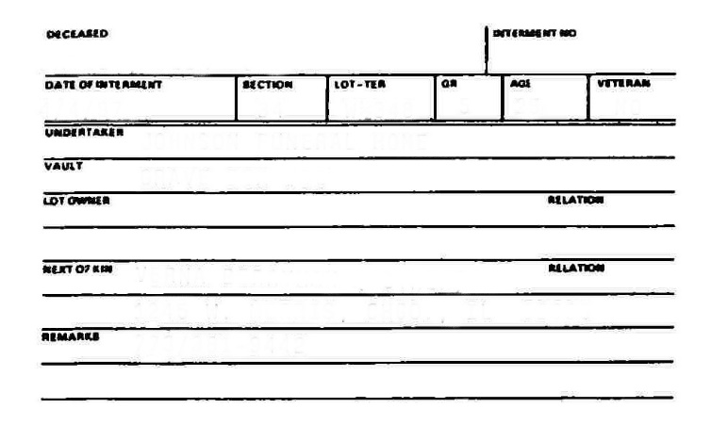
Data Extraction
Create an empty template for keypoint matching.

Slide 5
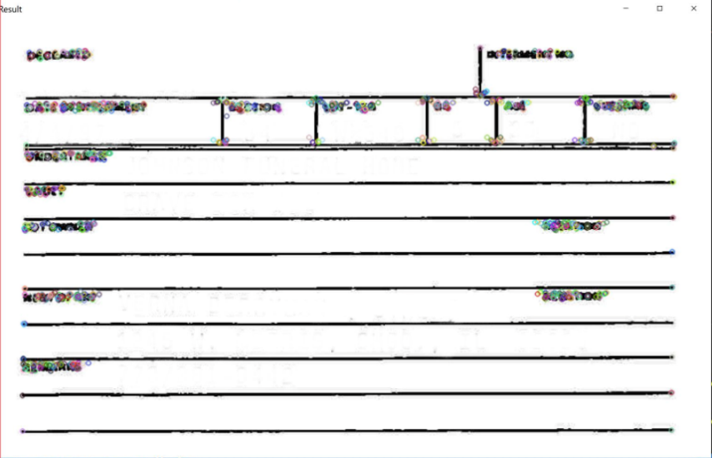
Detecting keypoints using orb.detectAndCompute

Slide 6
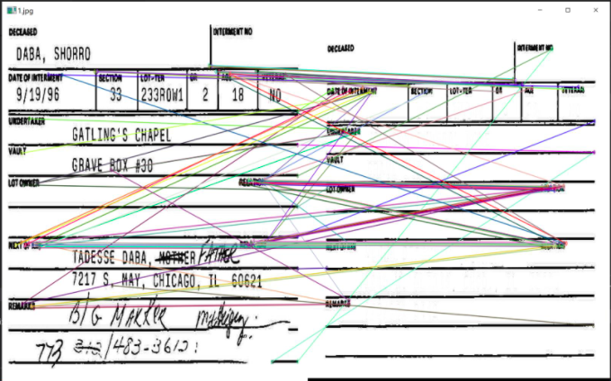
After the keypoints were detected, we used BruteForce Matcher to match the keypoints in our input image

Slide 7
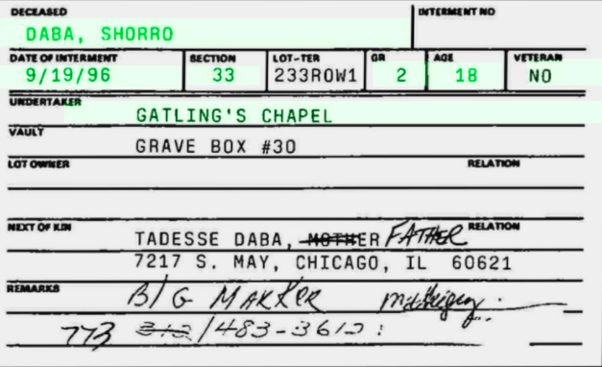




To extract the data and store it under the correct column names, we defined certain region of interests which was used to detect the area of text in the image

Slide 8
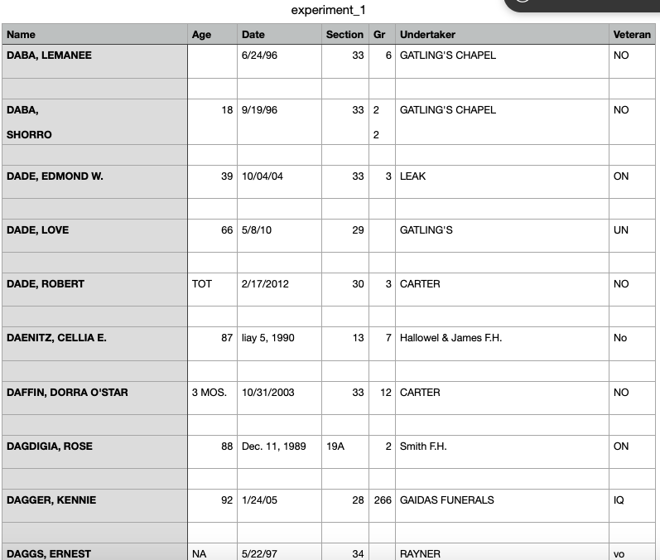
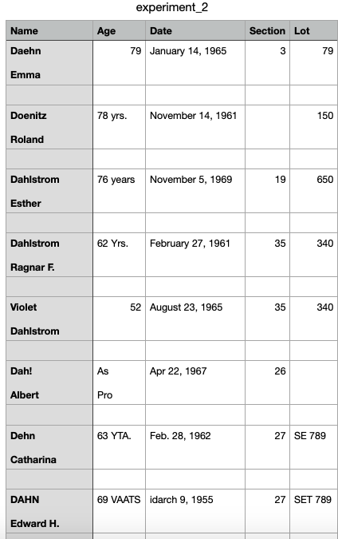
Extracted Unclean data
Type A
Type B

Slide 9
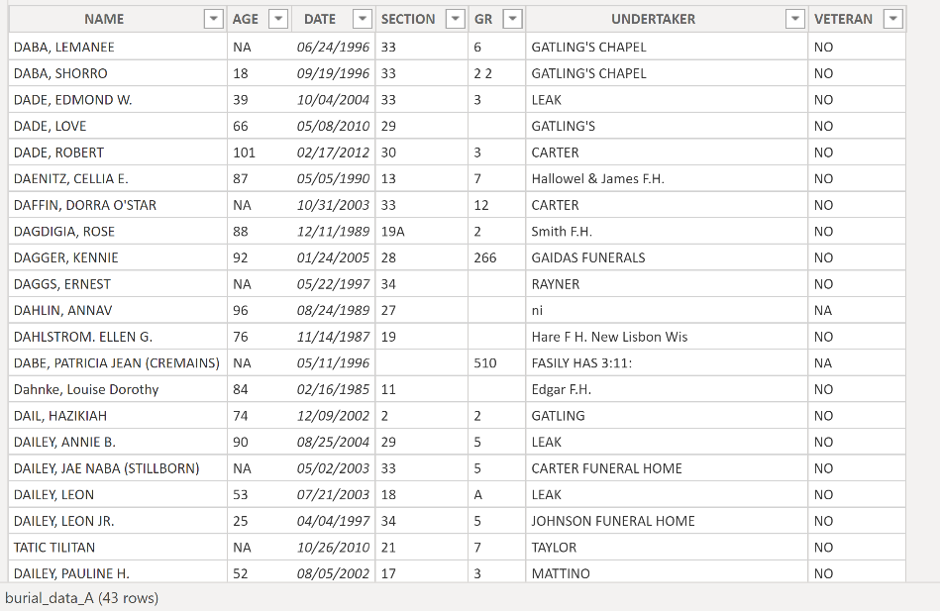
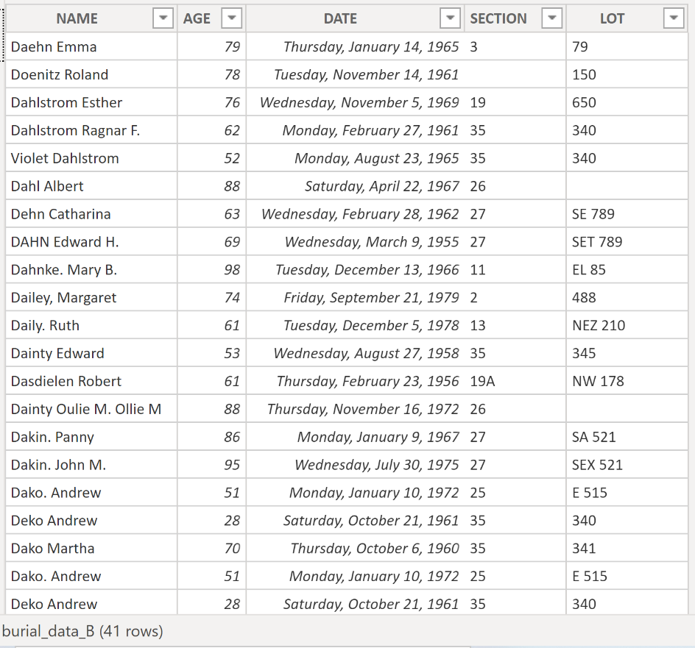
Data after cleaning
Type A Type B

Slide 10
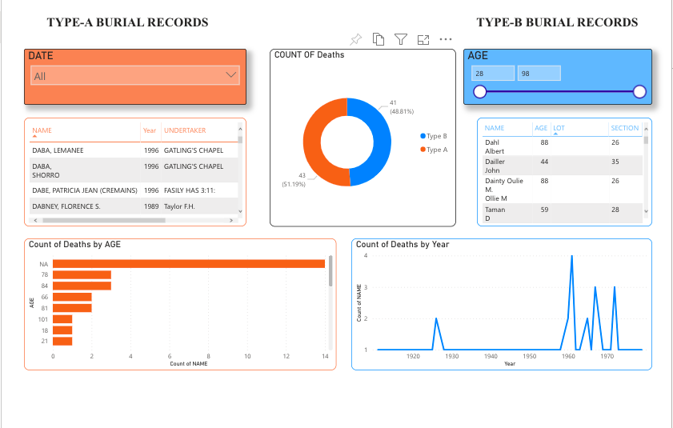
Report
The report was created using Power BI. The slicers can be used to interact with the report and look at various burials.
Per the report we were able to identify that Type A has higher percentage of deathrate after 78 years of age than Type B

Slide 11
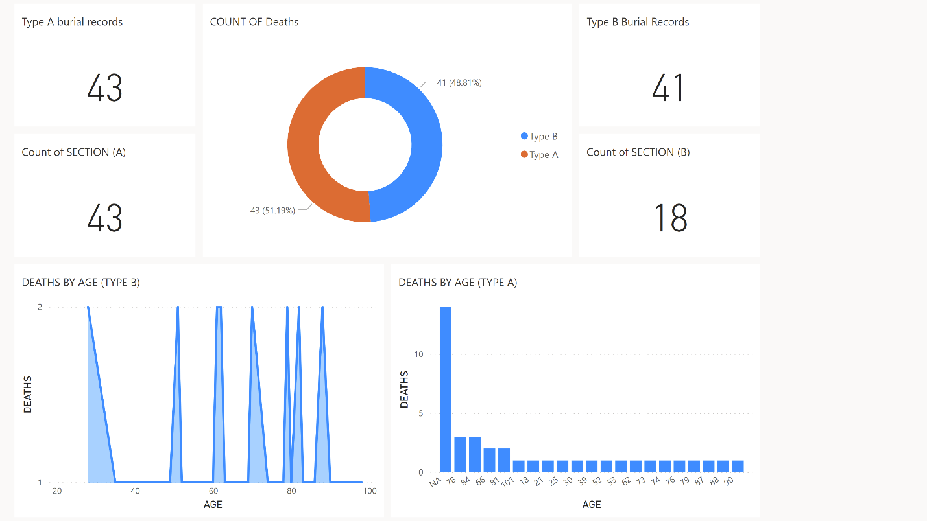
Dashboard
The dashboard gave us insights about the accuracy of the records read. Cloud Vision was able to accurately read the ‘Section’ of all type A records while it accurately read only 18 rows of ‘Section’ in Type-B. This difference can be attributed to missing information, incorrect placement of data, blurred or unreadable data in Type B records.

Slide 12
Conclusion
The tools used in this project have determined the answers that we were looking for. In the process we worked with Python language in IDE:VS Code combined with Cloud Vision API and OpenCV which were able to extract the images from the forms provided to us. These images were then saved into CSV files used for further analysis.
Type A which has 43 records collected and Type B which have 41 records collected display big difference in death rate. Type A has higher percentage of deathrate within the age of 75+ than Type B. The records are 14:1 which is a very drastic change. The extraction of the text and visualization method that were used gave a high percentage of accuracy within the analysis that were run in the process

Slide 13
THANK YOU

